Slide 1
Physics 201
Winter 2013
Bending time

Slide 2


Einstein’s Elevator
Winter 2013
=
=

Slide 3
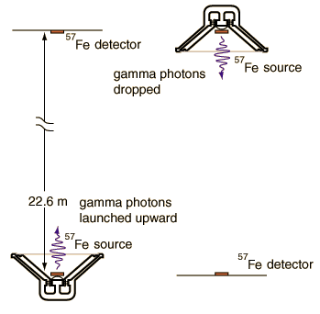
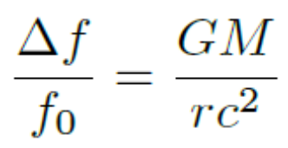
Gravitational Redshift
Winter 2013
Notes:
http://hyperphysics.phy-astr.gsu.edu/hbase/relativ/gratim.html

Slide 4
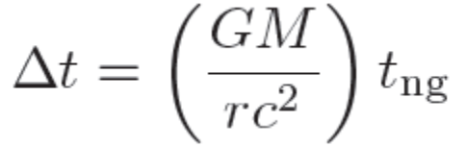
“Curved Time” and Weight
Winter 2013

Slide 5
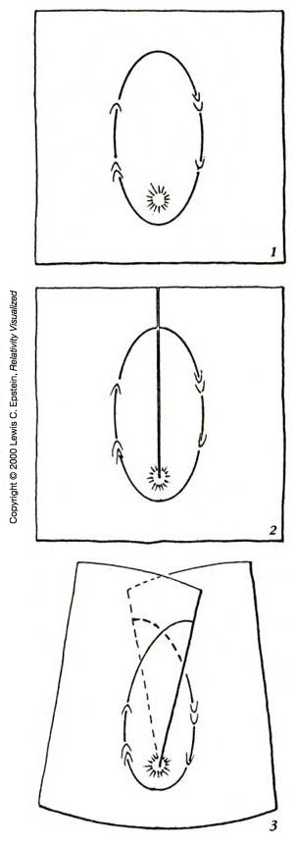
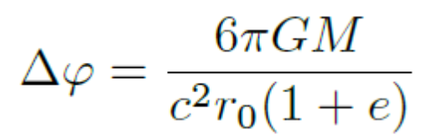

The Elevator is Limited: “Curved Space”
Winter 2013
Notes:
http://www.relativity.li/en/epstein2/read/i0_en/i1_en/

Slide 6
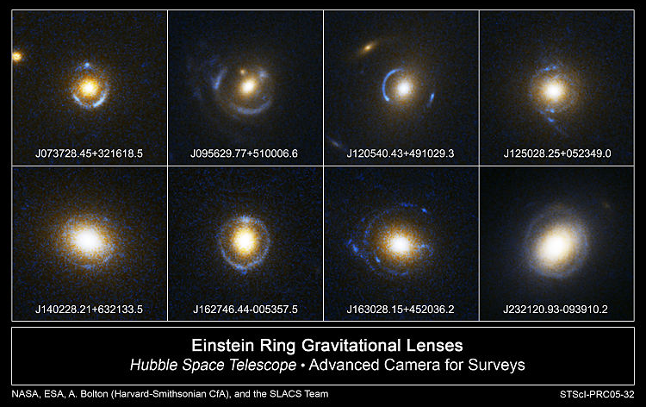
Einstein’s Field Equations
Winter 2013
Notes:
http://en.wikipedia.org/wiki/File:Einstein_Rings.jpg

Slide 7
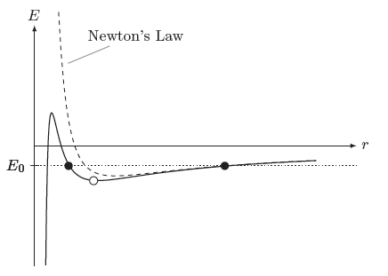
A New Effective Potential
Winter 2013

Slide 8
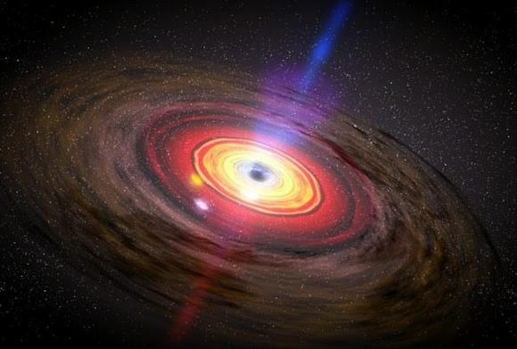
Black Holes: Event Horizon
Winter 2013
Notes:
http://www.universetoday.com/wp-content/uploads/2011/02/467382main_dn12679-1_600.jpg

Slide 9
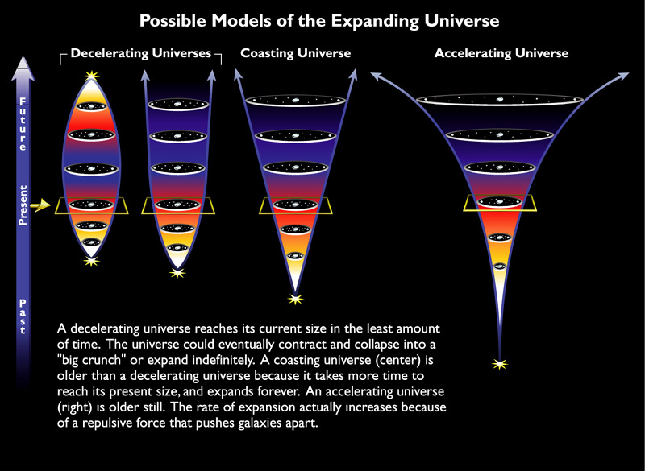
Einstein’s Biggest Blunder
Winter 2013
Notes:
http://hubblesite.org/newscenter/archive/releases/1999/19/image/k/format/large_web/

Slide 10
Physics 201
Winter 2013
Bending time

Slide 11
Does light fall?
1800: Yes; 1900: No.
1911: Einstein:
Equivalence Principle
  A person in free-fall does not feel his own weight
  A frame at rest in a gravitational field is equivalent to a accelerated frame
=
=

Slide 12
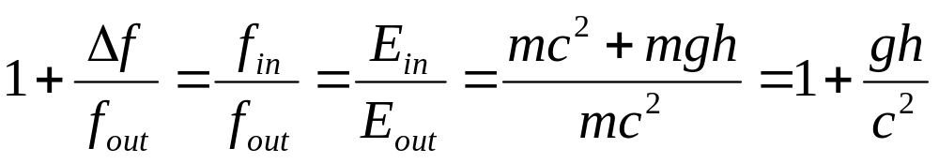
Falling light implies slow time
If light bends, the lower potion must run slow
How can light run slow? Violates relativity
Time itself slows down!
Also known as gravitational red-shift
Conservation of energy implies…

Slide 13
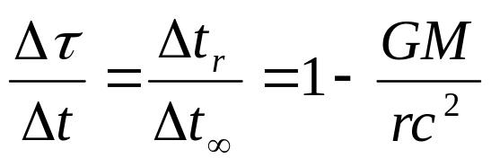
How can slow time explain gravity?
Slow time (missing space-time)
Position in space

Slide 14
Geodesics quantify curvature
Tidal forces imply space-
time is not Euclidian
(geodesic deviation)
Free-fall frames are
inertial, but limited
Force-free particles follow space-time “geodesics” (via inertial forces)
Inertial forces occur where the coordinate system changes
These changes are captured in the “metric” used to calculate the space-time interval

Slide 15
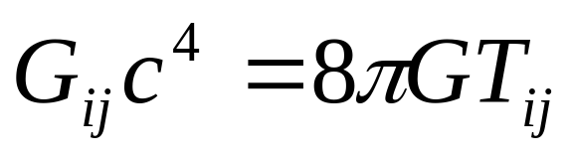
Einstein’s field equations
Connects space-time curvature (e.g., geodesic deviation) with mass-energy
Replaces Newton’s law of gravitation
“Solved” by specifying a space-time metric
“Einstein tensor”
Related to curvature of space-time
Related to density of mass-energy

Slide 16
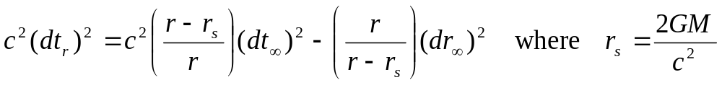
The Schwarzschild metric: gravitational field of a stationary and symmetric source
Space-time interval* in special relativity
Space-time interval* in general relativity
Gravitational red-shift
Orbital precession
Deflection of light
Black holes, etc...
Schwarzschild radius
*Angular dependence ignored

Slide 17
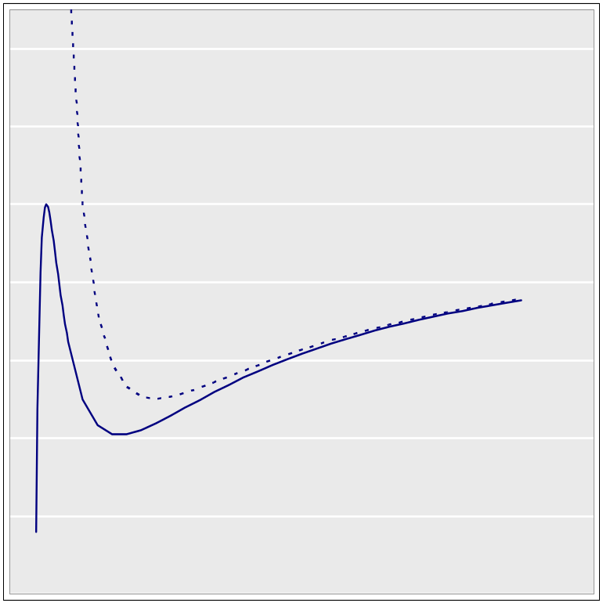
A new effective potential
New curve includes a “pit in the potential”
Slight shift causes orbital precession
Possible for an object (and light) to spiral to center
Newtonian effective potential

Slide 18
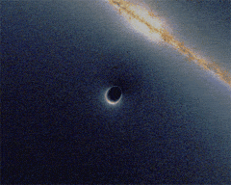
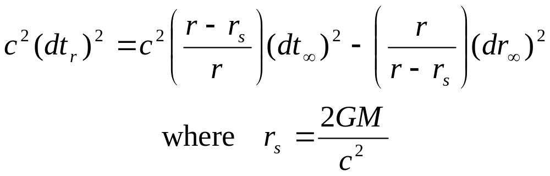
Black holes
What if r = r_{s}? Time stops. Nothing gets into a black hole (event horizon).
But can you fall into a black hole? Yes, nothing dramatic happens at the event horizon.
Large mass not required, but if mass > 3-4 solar masses, no known force can stop the gravitational collapse to a black hole
Notes:
Image source: http://en.wikipedia.org/wiki/File:Black_hole_lensing_web.gif

Slide 19
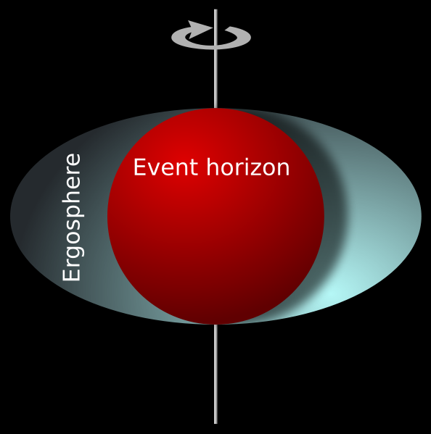
More on black holes
What if they spin? Schwarzschild metric cannot be used. Must develop new metric
Kerr metric
  Spinning objects drag frames
  Event horizon splits in two
  The “ergosphere”: frames
  dragged faster than light
  Penrose process possible
Source for quasars, gamma ray bursts?
Notes:
Image source: http://en.wikipedia.org/wiki/File:Ergosphere.svg

Slide 20

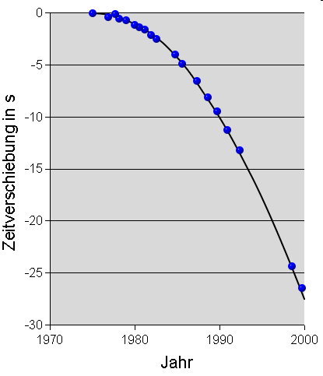
Gravitational radiation
Matter in motion can radiate gravitational waves (similar to electromagnetism)
A gravity wave causes tidal squishing
Binary pulsar system 1913+16 shows evidence of gravitational radiation
Power radiation is extremely small and as yet, undetected (Earth-Sun ~ 313 watts)
Notes:
Image source: http://en.wikipedia.org/wiki/File:GravitationalWave_PlusPolarization.gif
http://en.wikipedia.org/wiki/File:Psr1913%2B16-weisberg.png

Slide 21
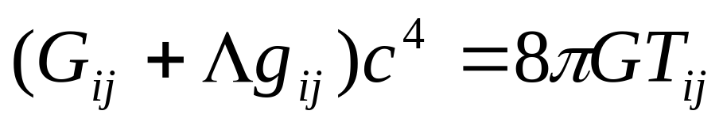
Einstein’s “greatest blunder”
Since the metric is
a potential, one can
add a constant
Einstein did this to allow a
“static” cosmological solution to his equation
Hubble’s law in 1929 provided evidence that the universe is expanding
Einstein immediately let Λ = 0 and called it the “greatest blunder” of his life
“Cosmological constant”

Slide 22
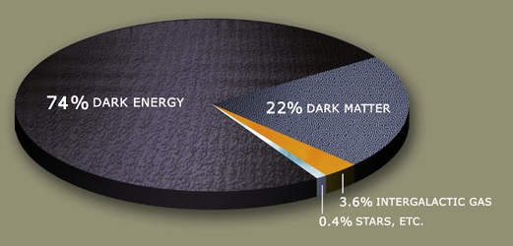
Dark energy, dark matter
Observations beginning
in the 1990s show that
the rate of expansion
is increasing
This implies that the cosmological constant Einstein rejected is actually slightly positive
This is popularly known as “dark energy”
Dark matter is unrelated but may point to further modifications of general relativity
Notes:
Image source: http://en.wikipedia.org/wiki/File:DarkMatterPie.jpg

